Slide 1
Tiny Project(CRUD operation)
Presented By
Jishnu. P. Nambiar

Slide 2
Introduction
This project have performed CRUD operations in IDE(Eclipse) by using MySQL database and JDBC. This is a basic project where it performs the CRUD operations and for this a appointment table has been created in database. And the code has been implemented accordingly.

Slide 3
Requirements
Software Requirements:
JDK (11.0.12)
Eclipse IDE
MySQL ( 8.0.28)
MySQL JDBC Driver
Hardware Requirements :
Operating System : Linux or Windows 7/8/10/11
RAM : 512MB (minimum)
Hard Disk : 20GB

Slide 4
Database Table
appointment
Attribute Name | Data type and size | Constraints | Description
a_id | int | Primary key | Auto Increment
pname | varchar(30) | Not Null | Patient name
dname | varchar(30) | Not Null | Doctor name
phone | bigint | Not Null, Unique | Patient Contact
apdate | date | Not Null | Appointment Date

Slide 5
CRUD
CRUD Operations
C - Create/ insert in table
R - Read from table
U - Update in table
D - Delete from table
This are the Operations that we have performed in this program.

Slide 6
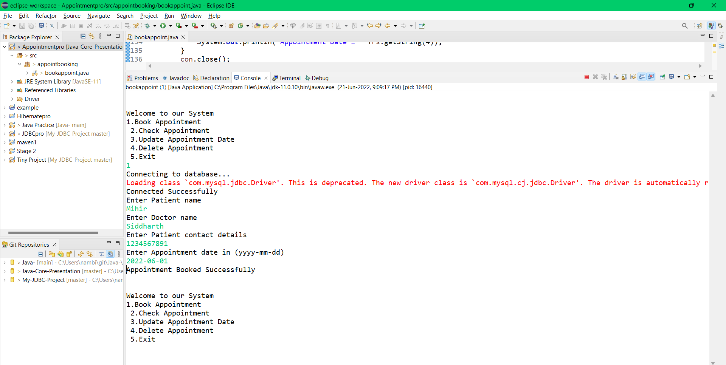
Insert / Booking from Appointment (Eclipse)

Slide 7
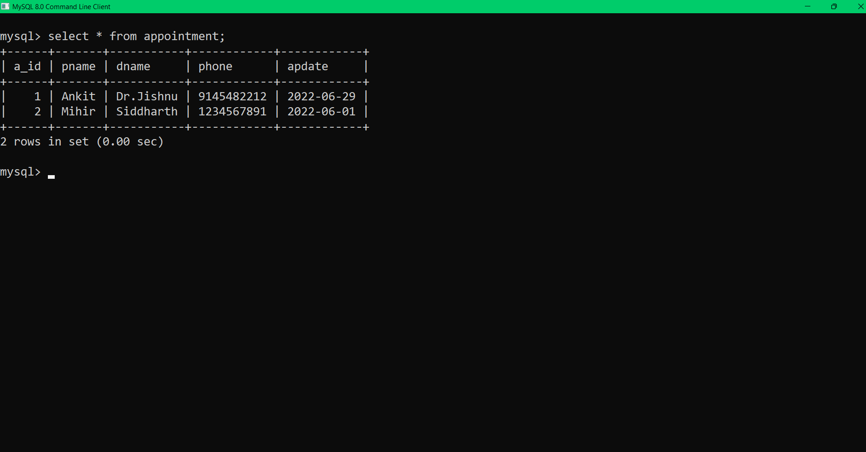
Insert / Appointment Booked (Database)

Slide 8
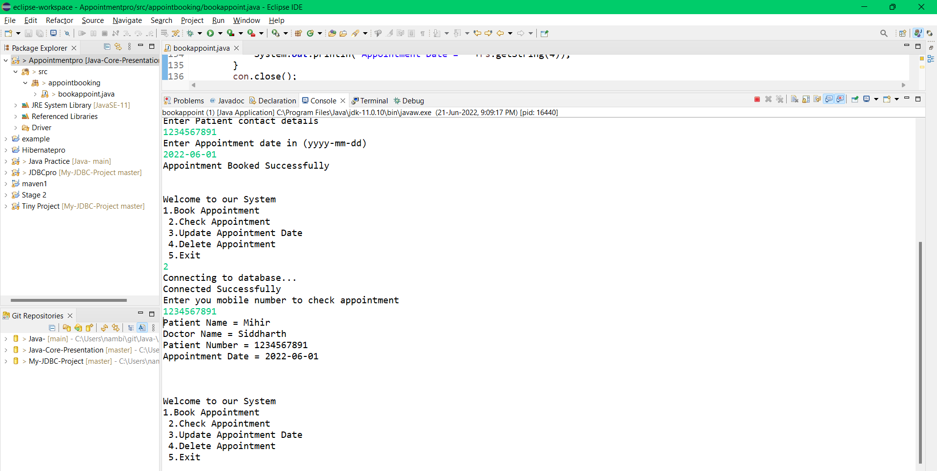
Read/ Viewing Appointment (Eclipse)

Slide 9
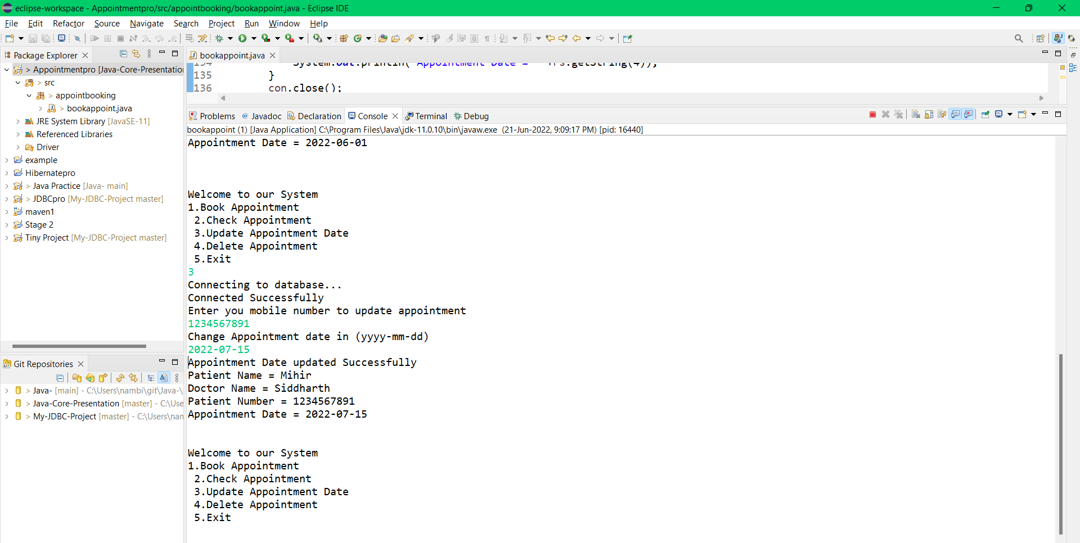
Update/ Updating Appointment date (Eclipse)

Slide 10
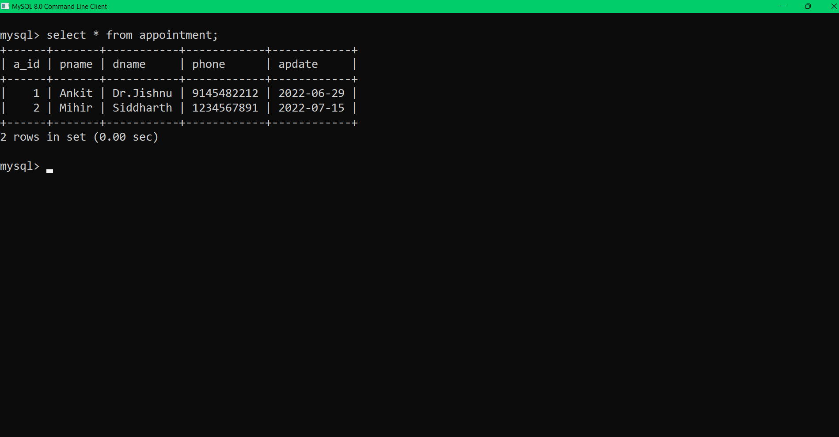
Update/ Appointment date Updated (Database)

Slide 11
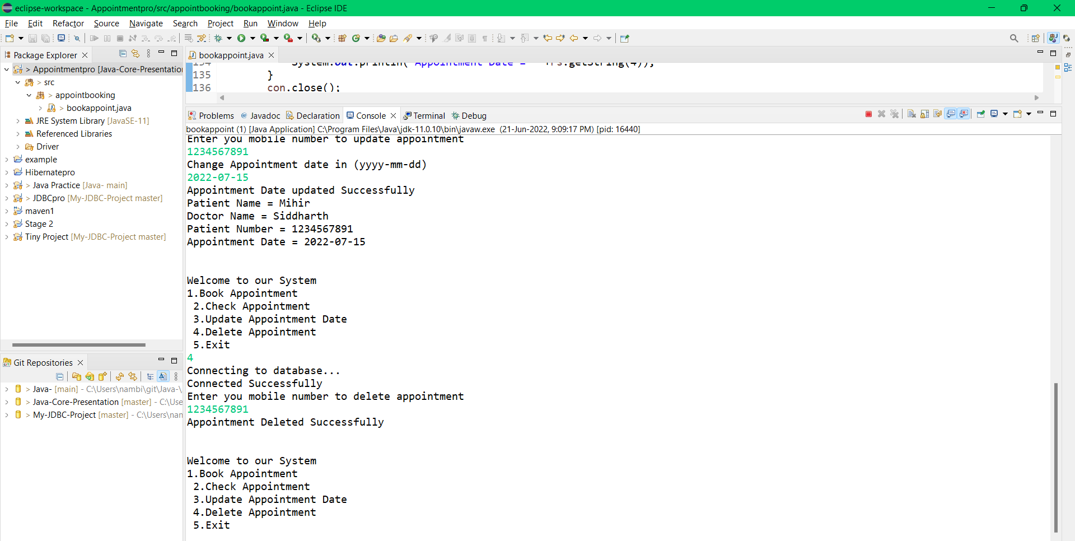
Delete/ Deleting Appointment (Eclipse)

Slide 12
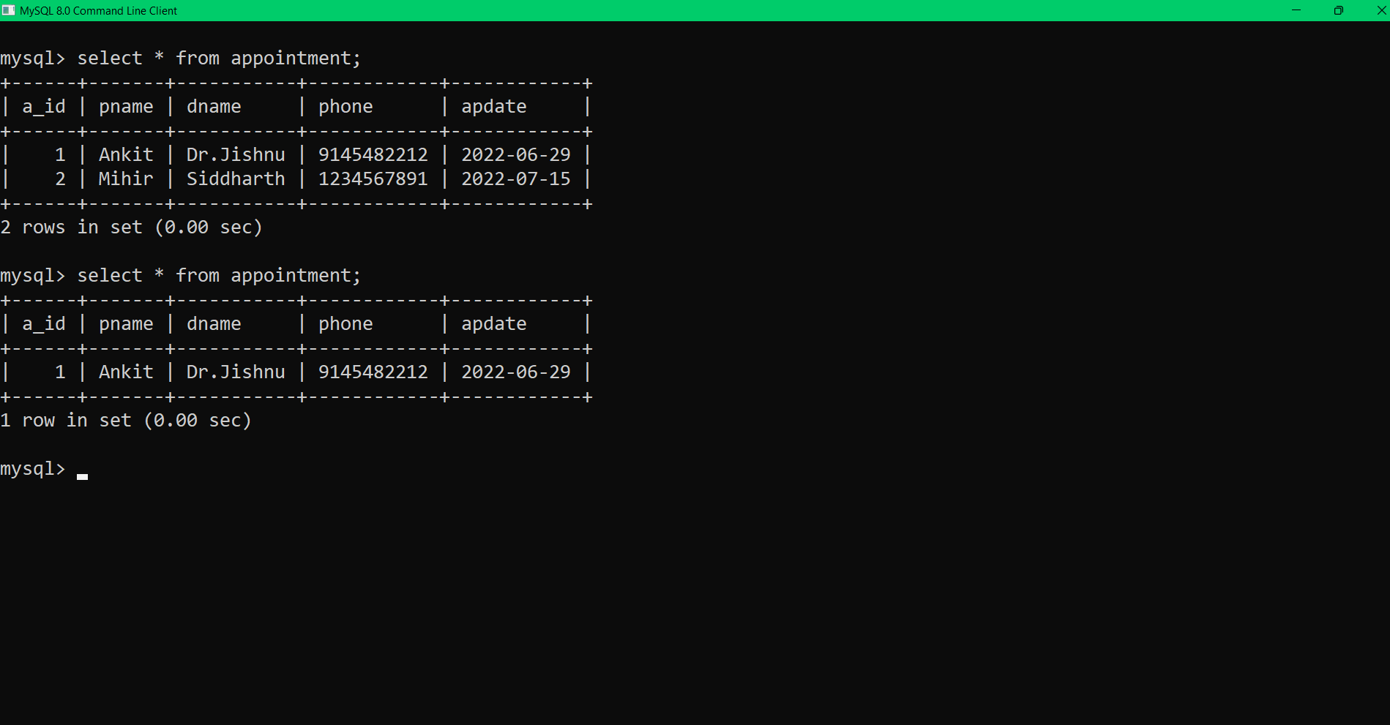
Delete/ Appointment Deleted (Database)

Slide 13
Conclusion
CRUD operations are the basic in almost all of the projects. That’s the main reason why we have used this operations and from this project we have concluded that we can perform CRUD operations from eclipse using JDBC connections. The Project is successfully performed in given environment.

Slide 14
THANK YOU

